Slide 1



PixelPerfection
PixelPerfection AI
Transform Pixels, Illuminate Moments
Upscaling…
23%

Slide 2
Outlines:
Introduction
Our Web App – Features
Understanding the Architecture
Why choose PixelPerfection AI?
Promotion Strategy
Contact Us

Slide 3
Our Web App
Our Mobile app, PixelPerfection AI, is a one-step solution to your low-quality images, it will transform the pixels and give life to your low-quality images by using AI algorithms, powered by OpenAI API keys and other AI technologies.
Application Features:
  Image Upscaling
  User-Friendly Interface
  Downloadable Output
  Privacy Assurance

Slide 4
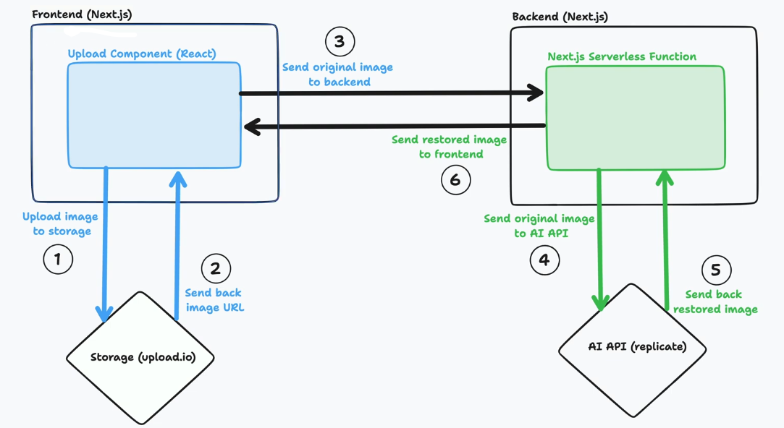
Understanding the Architecture

Slide 5

Understanding the Architecture
PixelPerfection
PixelPerfection
PixelPerfection
Upload
Render
Rendering…
Settings
Settings
23%

Slide 6
Understanding the Architecture
PixelPerfection
PixelPerfection
PixelPerfection
Regenerate
Regenerating…
Regenerate
Download
Download
Download
63%

Slide 7
WHY CHOOSE PIXELPERFECTION AI?
PixelPerfection AI excels by combining technological prowess with user-centric design. The seamless integration of advanced AI ensures that users experience a significant enhancement in their images. Our commitment to privacy and a focus on delivering a simple yet powerful tool sets us apart from the competition. In a market saturated with image enhancement apps, PixelPerfection AI shines as a beacon of innovation, transforming pixels and illuminating moments like never before.

Slide 8
PROMOTION STRATEGY
Social Media Campaigns: Engage users through platforms like Instagram, Facebook, and Twitter. Influencer Collaborations: Partner with influencers to showcase the app's capabilities. Free Trial Period: Offer an initial free trial period to encourage user engagement.

Slide 9
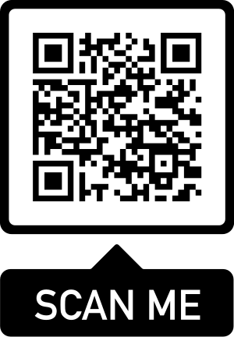
CONTACT US!
PixelPerfect square Rd, Farnworth, Bolton BL4OJR
United Kingdom
contact@pixelpefection.ai
www.pixelperfection.ai

